Slide 1

ITSS Software Development Capstone
EcoPark Bike Rental System – ECOB

Slide 2
Contents
Contribution
Interaction diagram
Class diagrams
Design considerations

Slide 3
Contribution
Member | Contribution | Rate
Bui Manh Tu 20194870 | Return Bike use case Review changes | 40%
Le Huy Hoang | View Bike Info, View Station Info use case Build, demo Final testing | 30%
Nguyen Vu Minh | Rent Bike, Make Transaction use case Optimization, Documentation | 30%

Slide 4
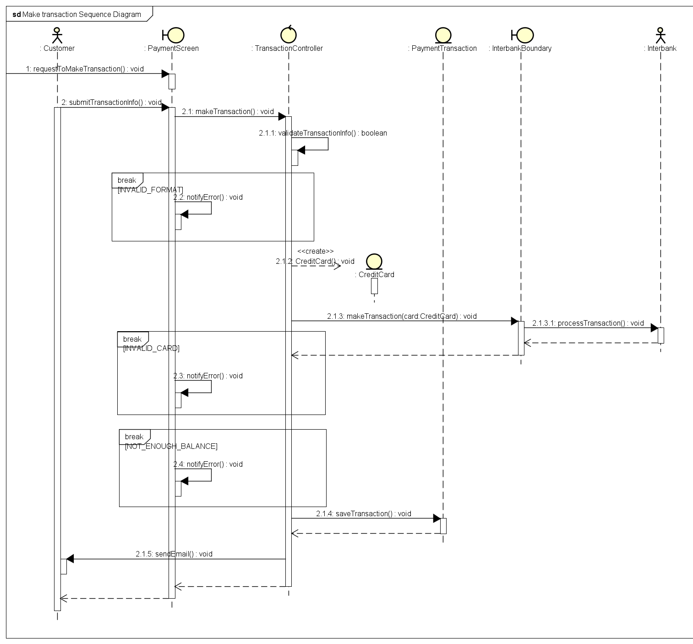
Interaction diagram
Make Transaction use case diagram:
Screen
Controller
Entity
Boundary

Slide 5
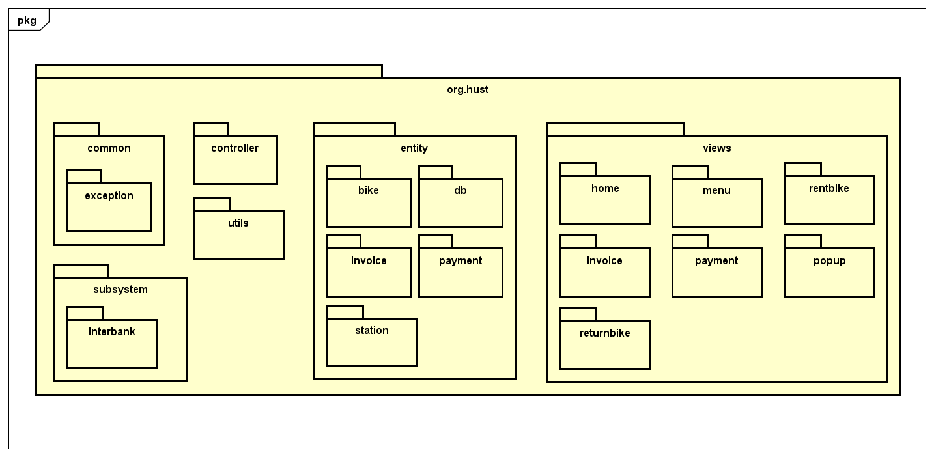
Class diagrams
Package Design

Slide 6
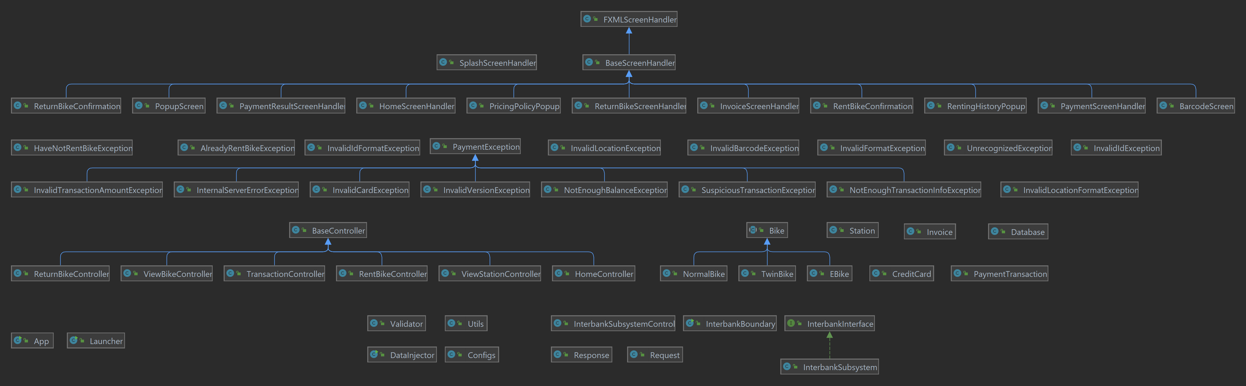
Class Diagram
General Class Diagram

Slide 7
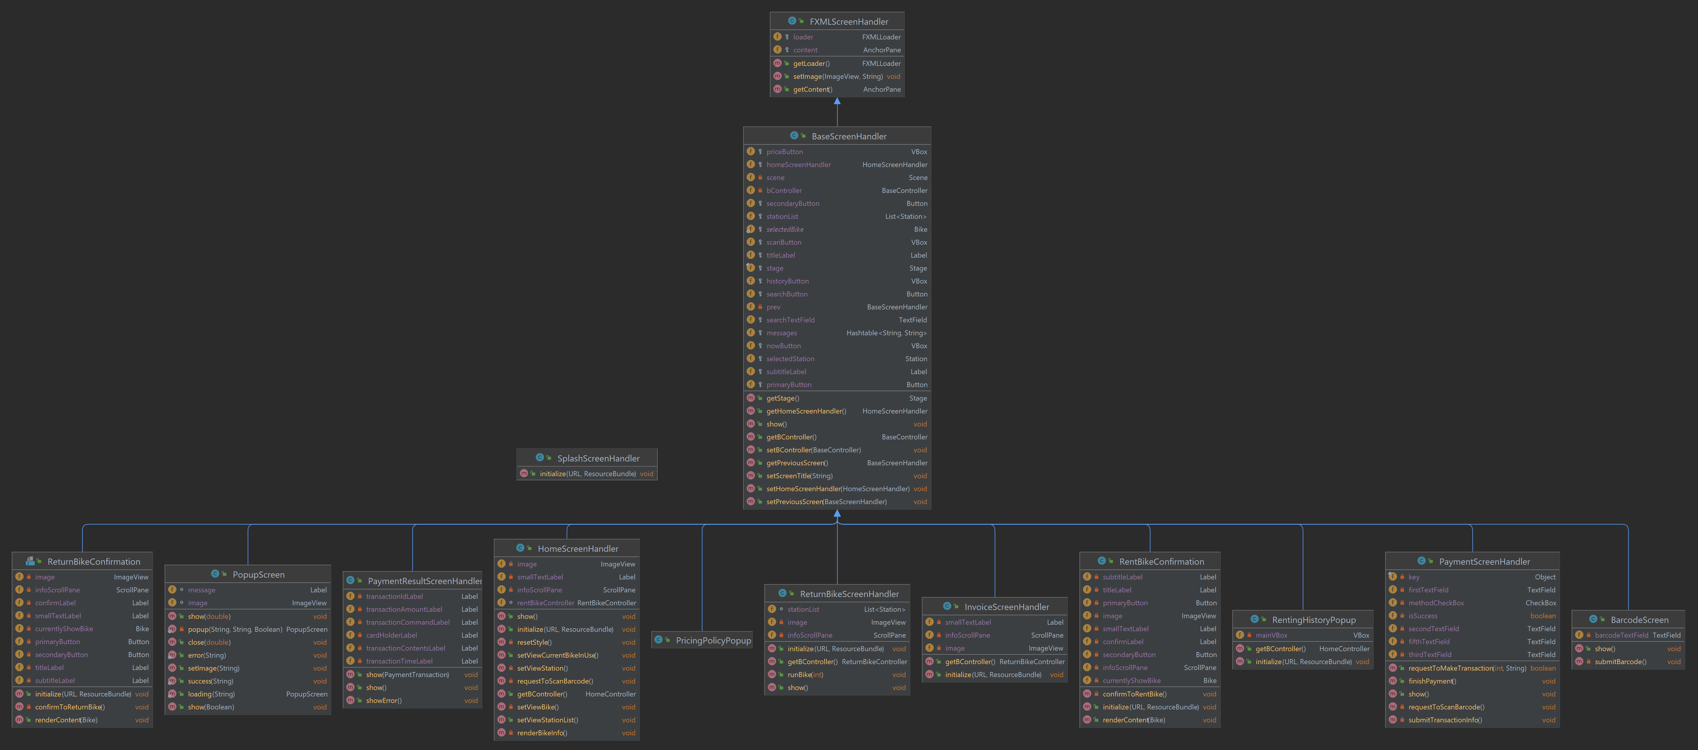
Class diagram: view package

Slide 8
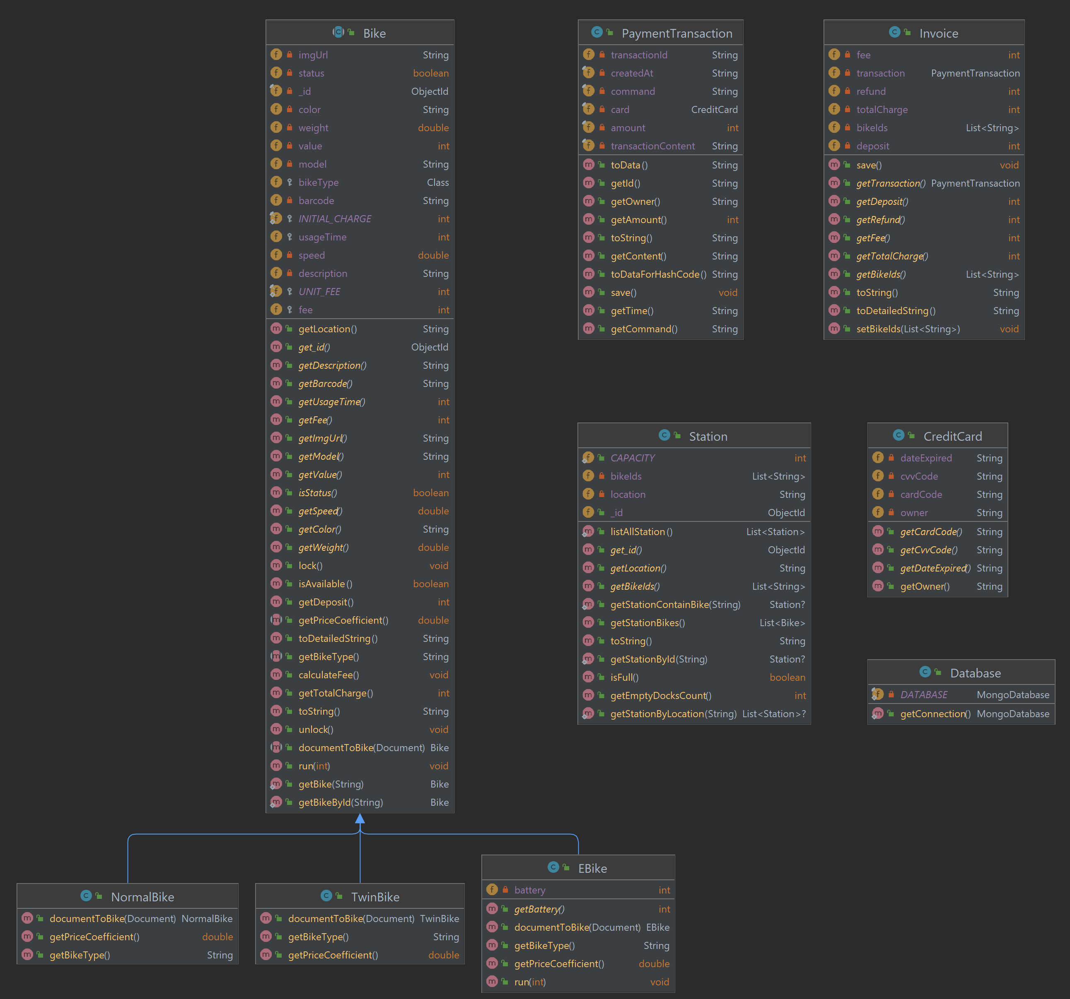
Class diagram: entity package
Bike
NormalBike
TwinBike
Ebike
PaymentTransaction
Invoice
Station
CreditCard
Database

Slide 9
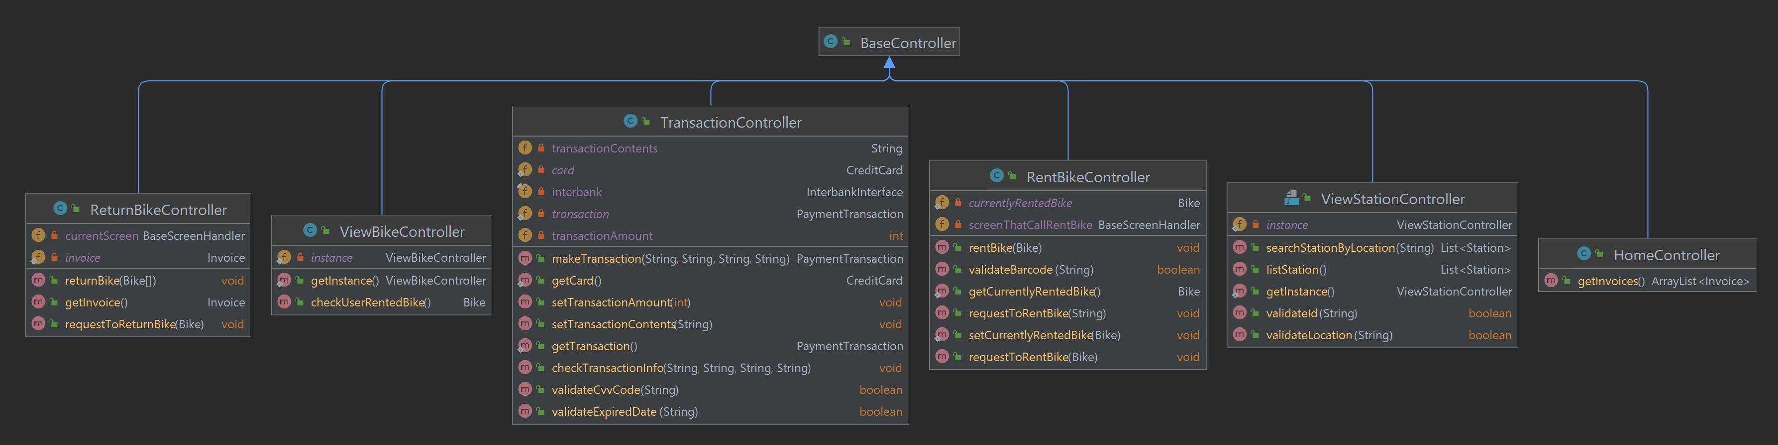
Class diagram: controller package

Slide 10
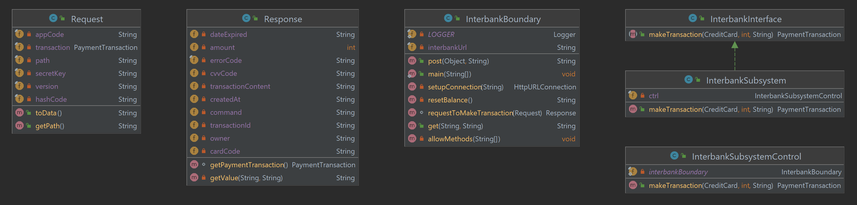
Class diagram: subsystem package

Slide 11
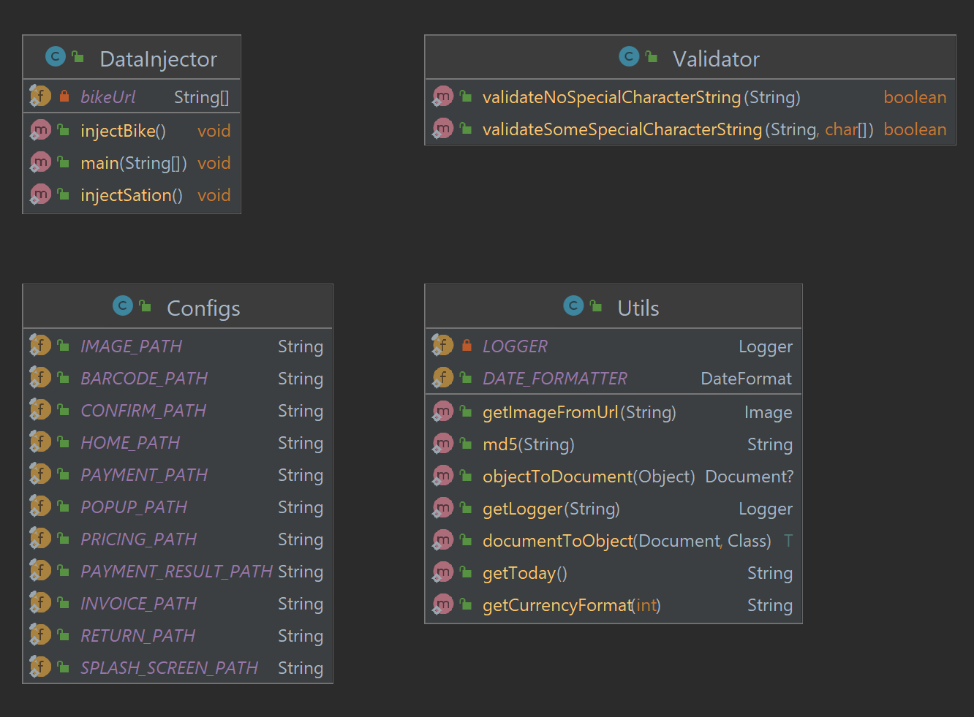
Class diagram: utils package

Slide 12
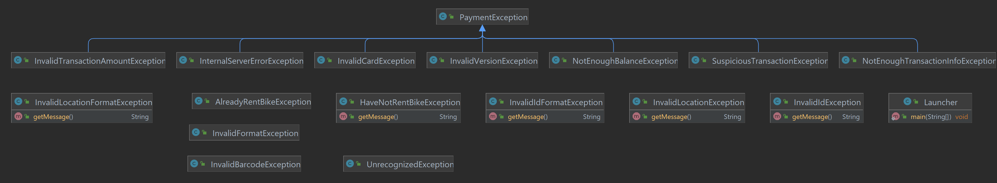
Class diagram: exception package

Slide 13
Design considerations

